Slide 1

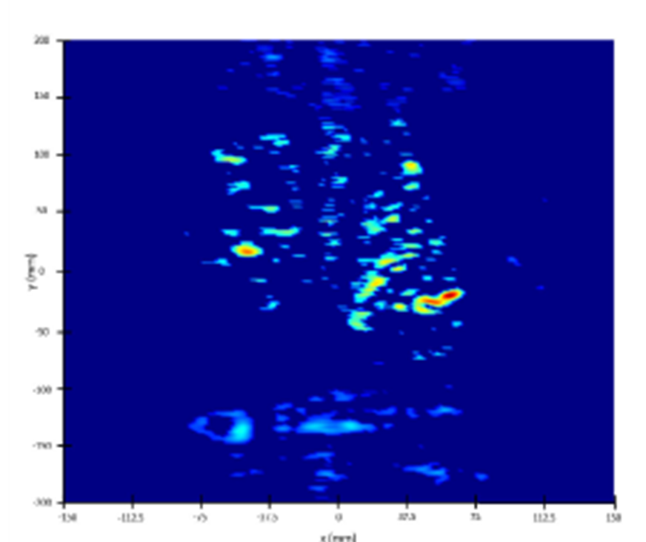
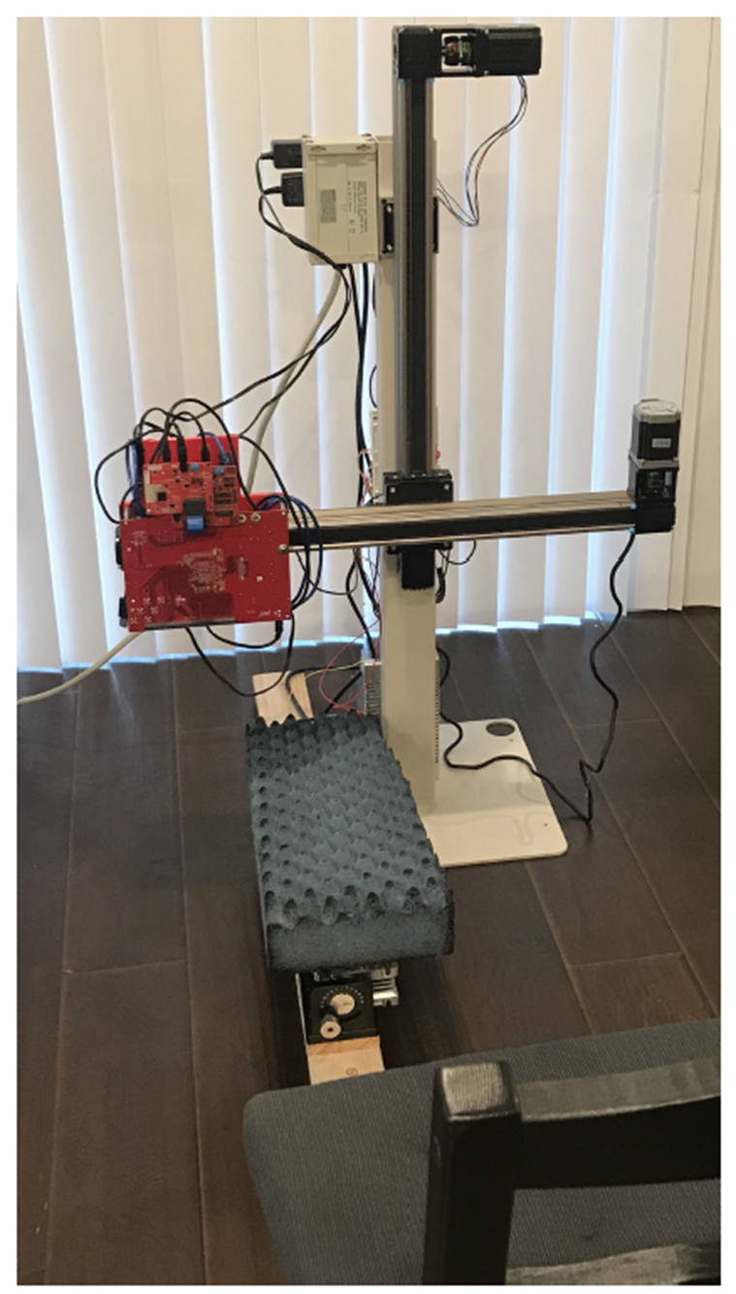
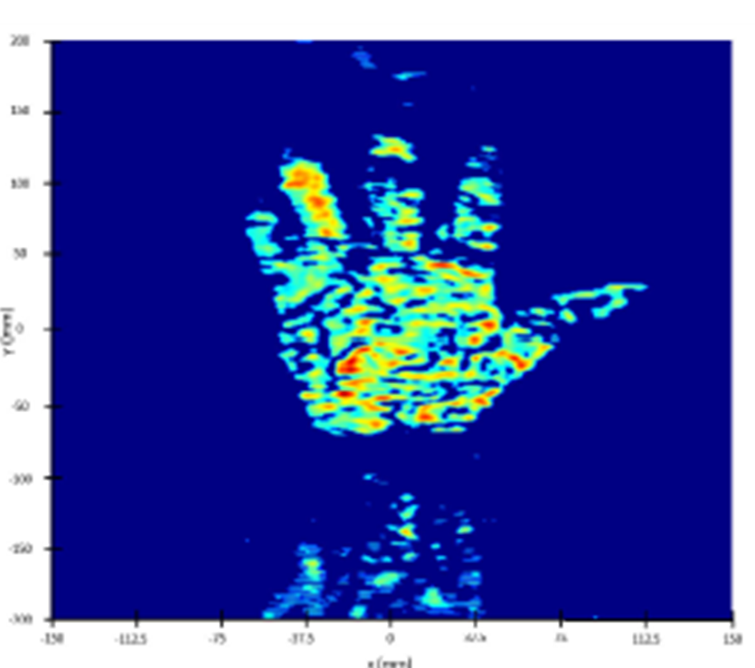
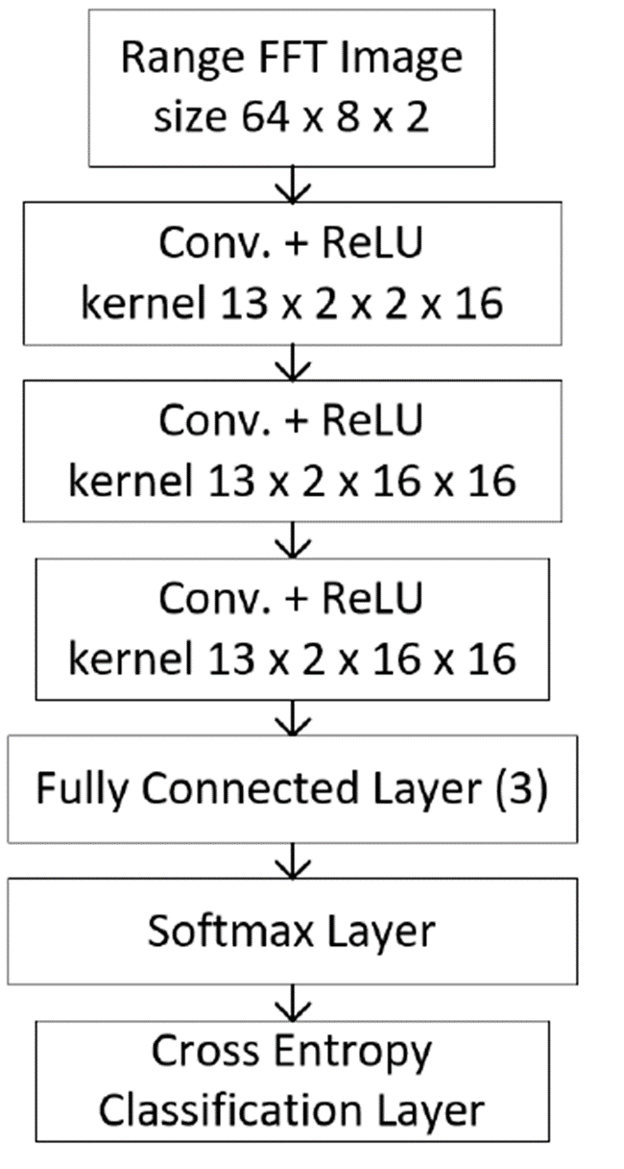
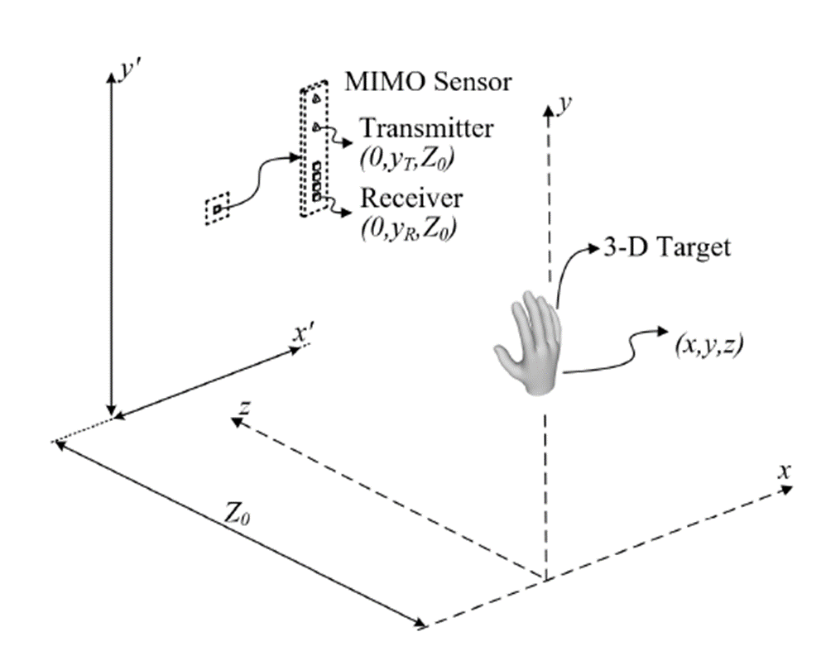
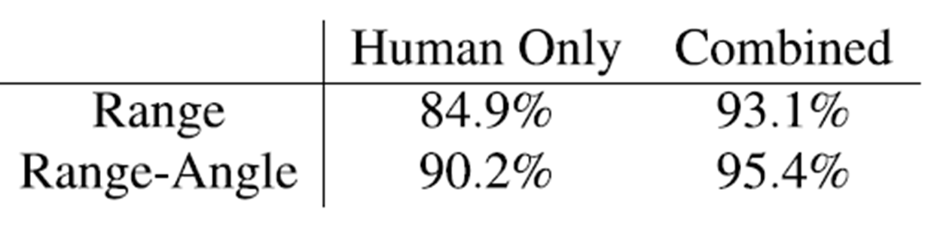
Improved Static Hand Gesture Classification on Deep Convolutional Neural Networks Using Novel Sterile Training Technique Christos Vasileiou, University of Texas at Dallas, GRC/TxACE
OBJECTIVE:
data collection and a novel technique for deep CNN training by introducing ``sterile'' images which aid in distinguishing distinct features among the static gestures and subsequently improve the classification accuracy.
APPROACH:
Sample human hand gestures within the scanning range of 0.25 m and 0.25 m from the radar and to a square with sides of 0.25 m.
Perform the gesture with the hand kept away from the torso to avoid occluding the hand in the torso peak’s side-lobes.
Collect dataset from many perspectives using 2D mechanical scanner from both “real” human hands and sterile aluminum cutouts.
Apply a synthetic radar aperture (SAR) approach to reconstruct an image of the human hand with and without aluminum cutout.
Preprocess complex-valued data by applying multistatic-to-monostatic conversion along with either range or range-angle FFTs.
Develop CNN architectures keeping in mind that inputs normalization may ruin the phase interdependence.
Train CNN architectures by using dataset with both real and sterile images.
RESULTS: Prediction accuracy of the dataset with sterile aluminum cutouts has been improved for both range and range-angle algorithms to 93.1% and 95.4%, respectively.

